Slide 1
MOCK C
FSA,HoChiMinh
1

Slide 2
Table of Contents
1
MOCK description
2
Architecture design of MOCK
3
Detail functions of MOCK
4
Simulation
2

Slide 3
MOCK description
3

Slide 4
MOCK Description
Description
- Write a number guesting game as following descriptions
- User could enter their name when starting program
- For each round, the program generates randomly a magic number which has 6 digits.
- The user guests and enter 1 number each time. If there are matched number, the program prints
out the result and the magic number (which guested number in correct position, the remaining are '-')
- Whenever the player could explore the magic number, print out their lucky ratio correct guess total guess
- Print out the lucky ratio history of the program, with at least 5 highest player.
4

Slide 5
Architecture Design Of MOCK
5

Slide 6
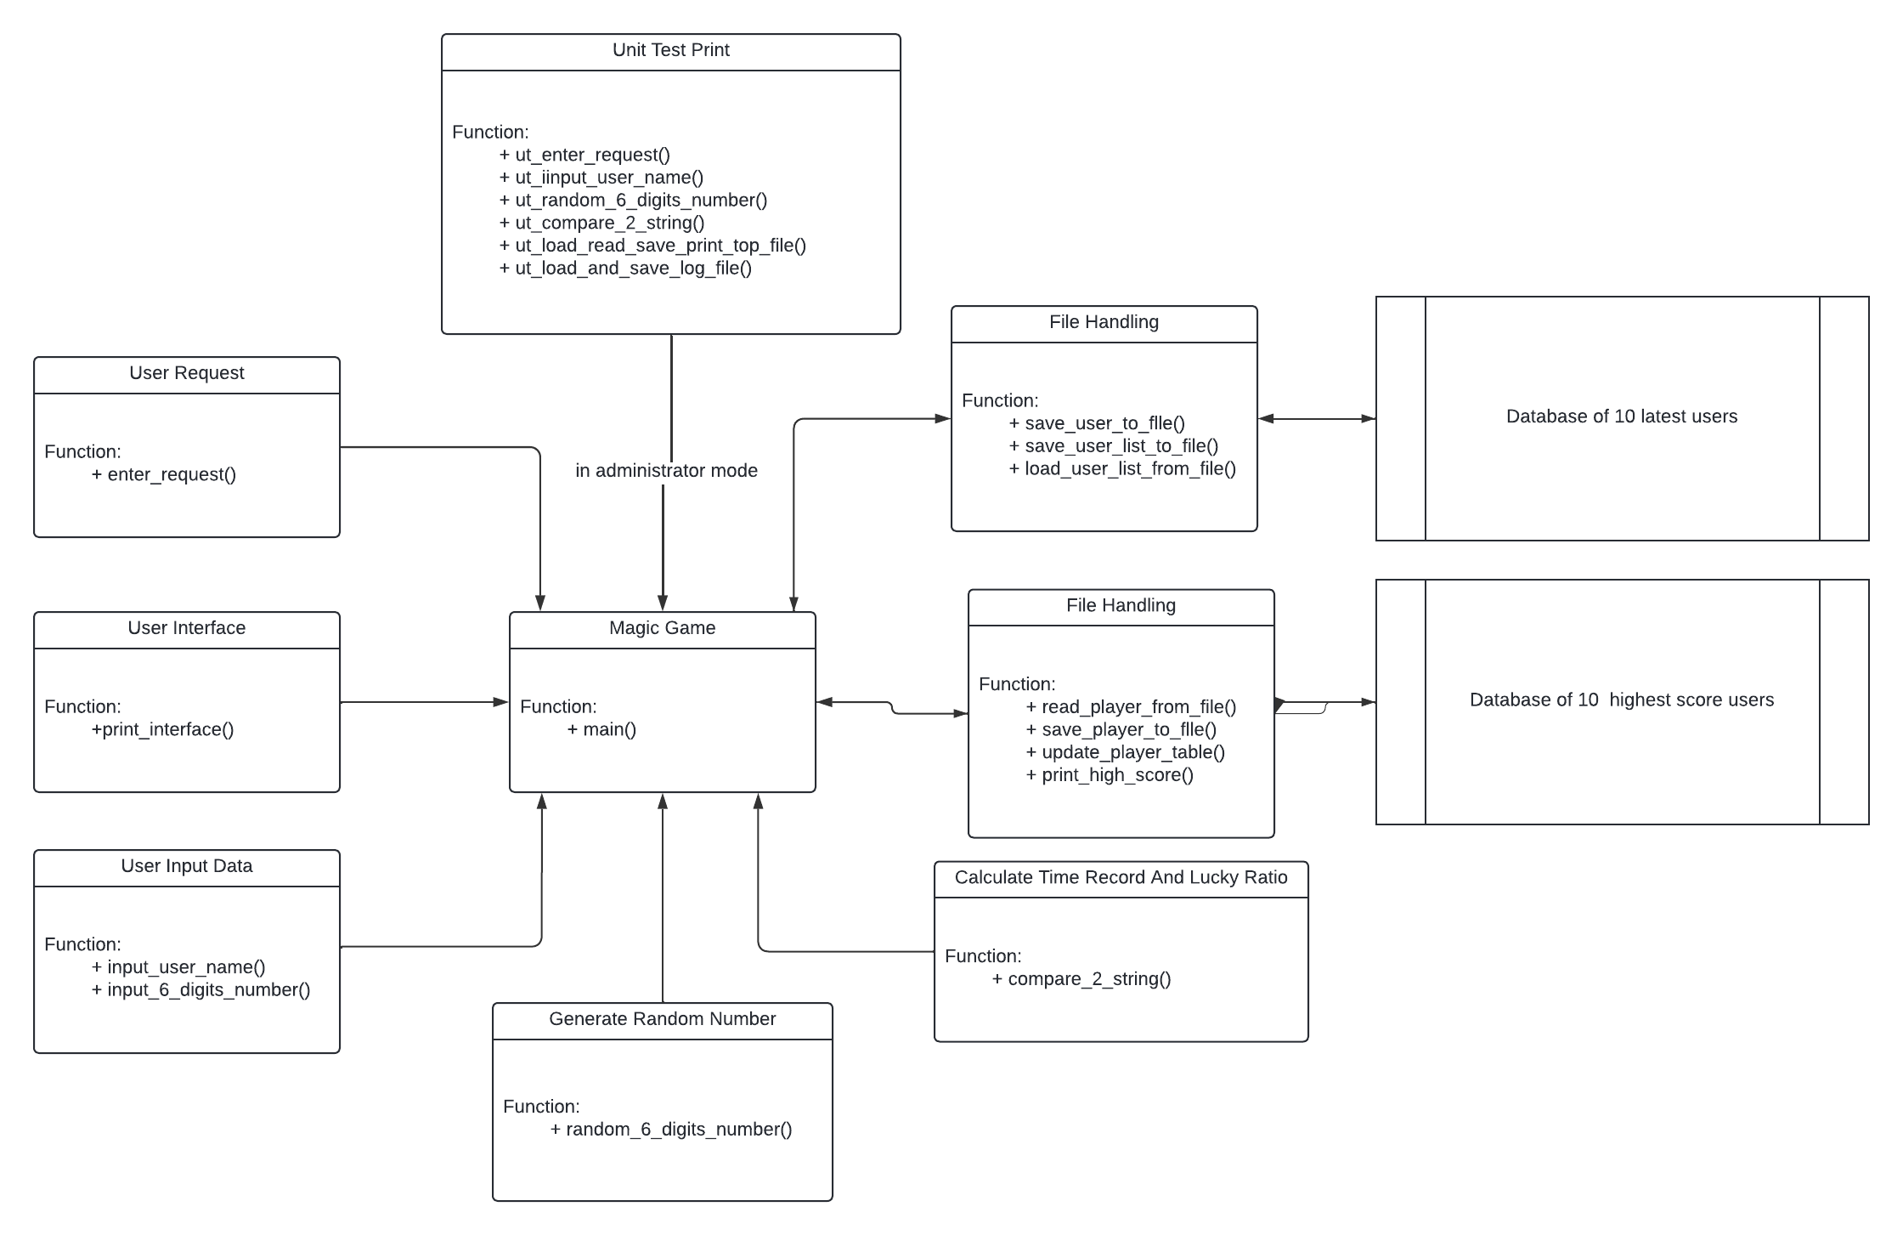
Architecture design of MOCK
6

Slide 7
Detail Functions Of MOCK
7

Slide 8
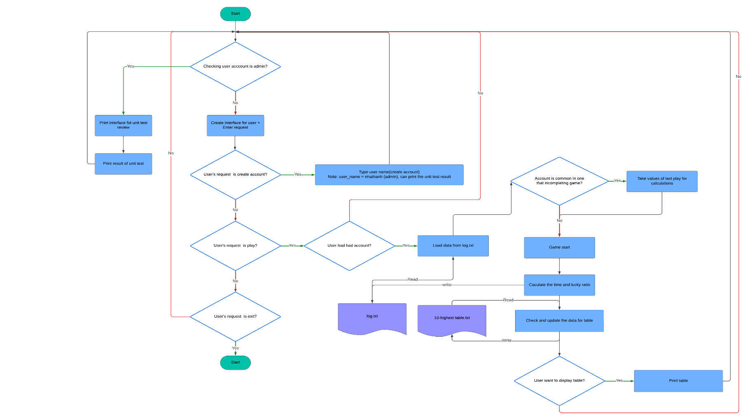
main()
8

Slide 9
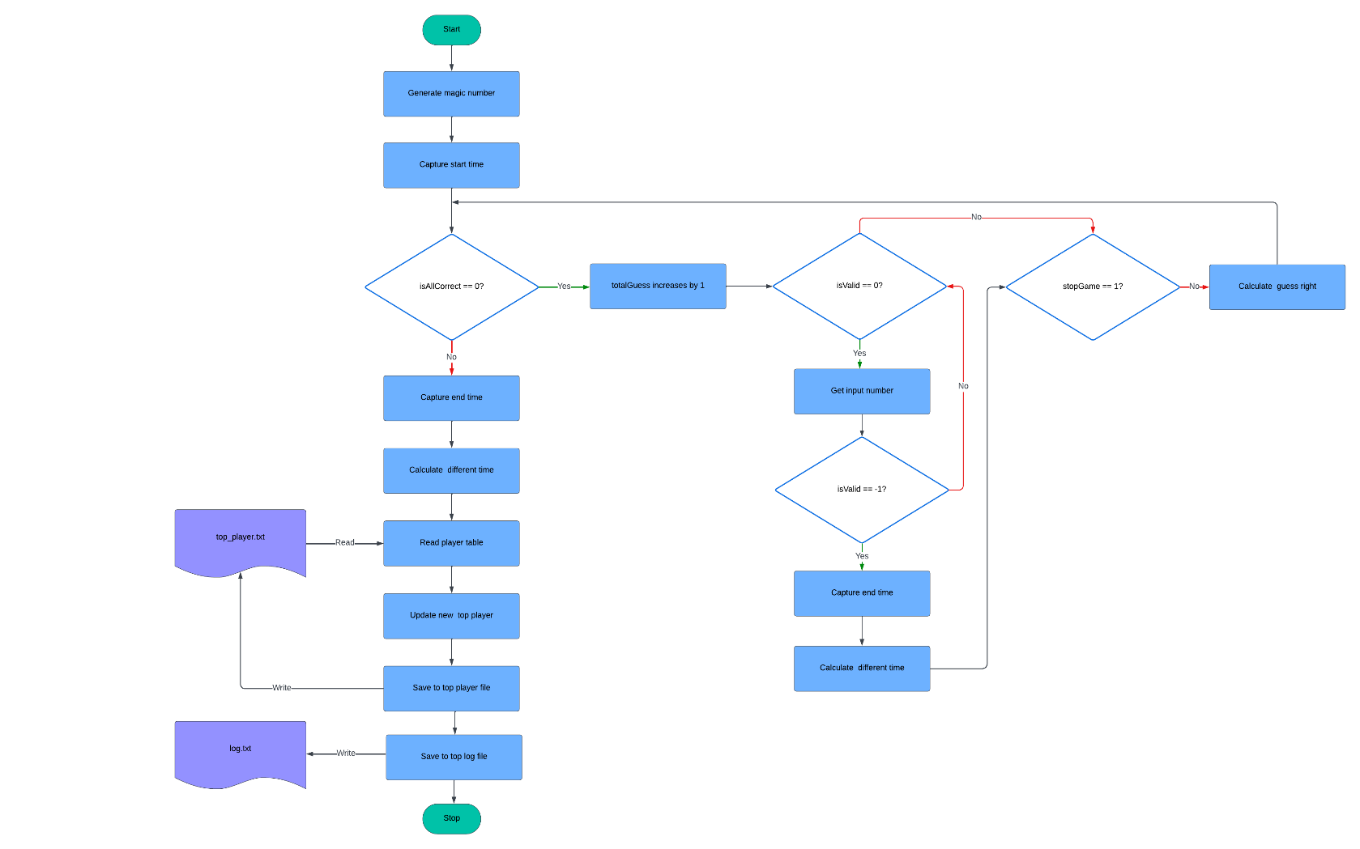
main() (Calculate and save)
Note:
+ isAllCorrect: Check guess all done
+ isValid: check input valid
+ stopGame: Check stop game
+ totalGuess: Total guess time
9

Slide 10
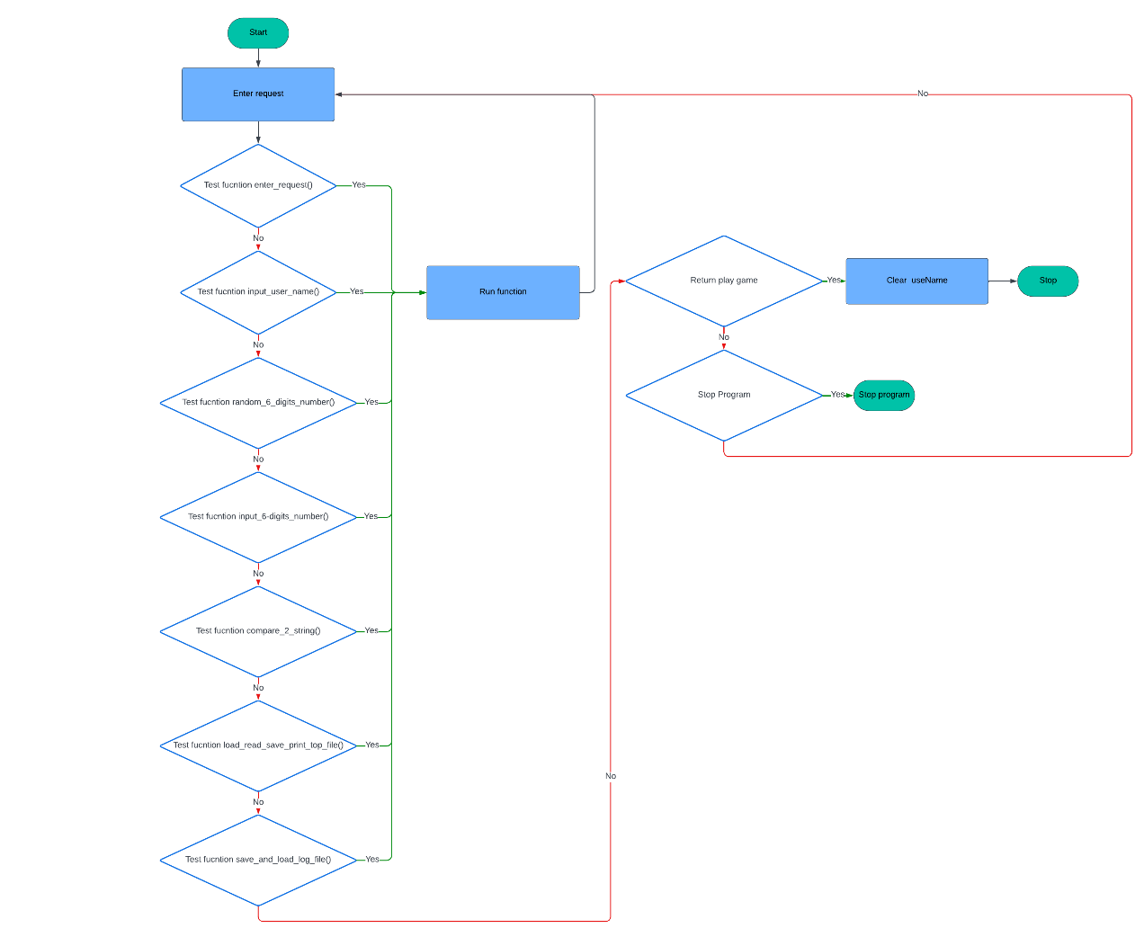
main() (Unit test)
Note:
+ userName: store account(user’s name)
10

Slide 11
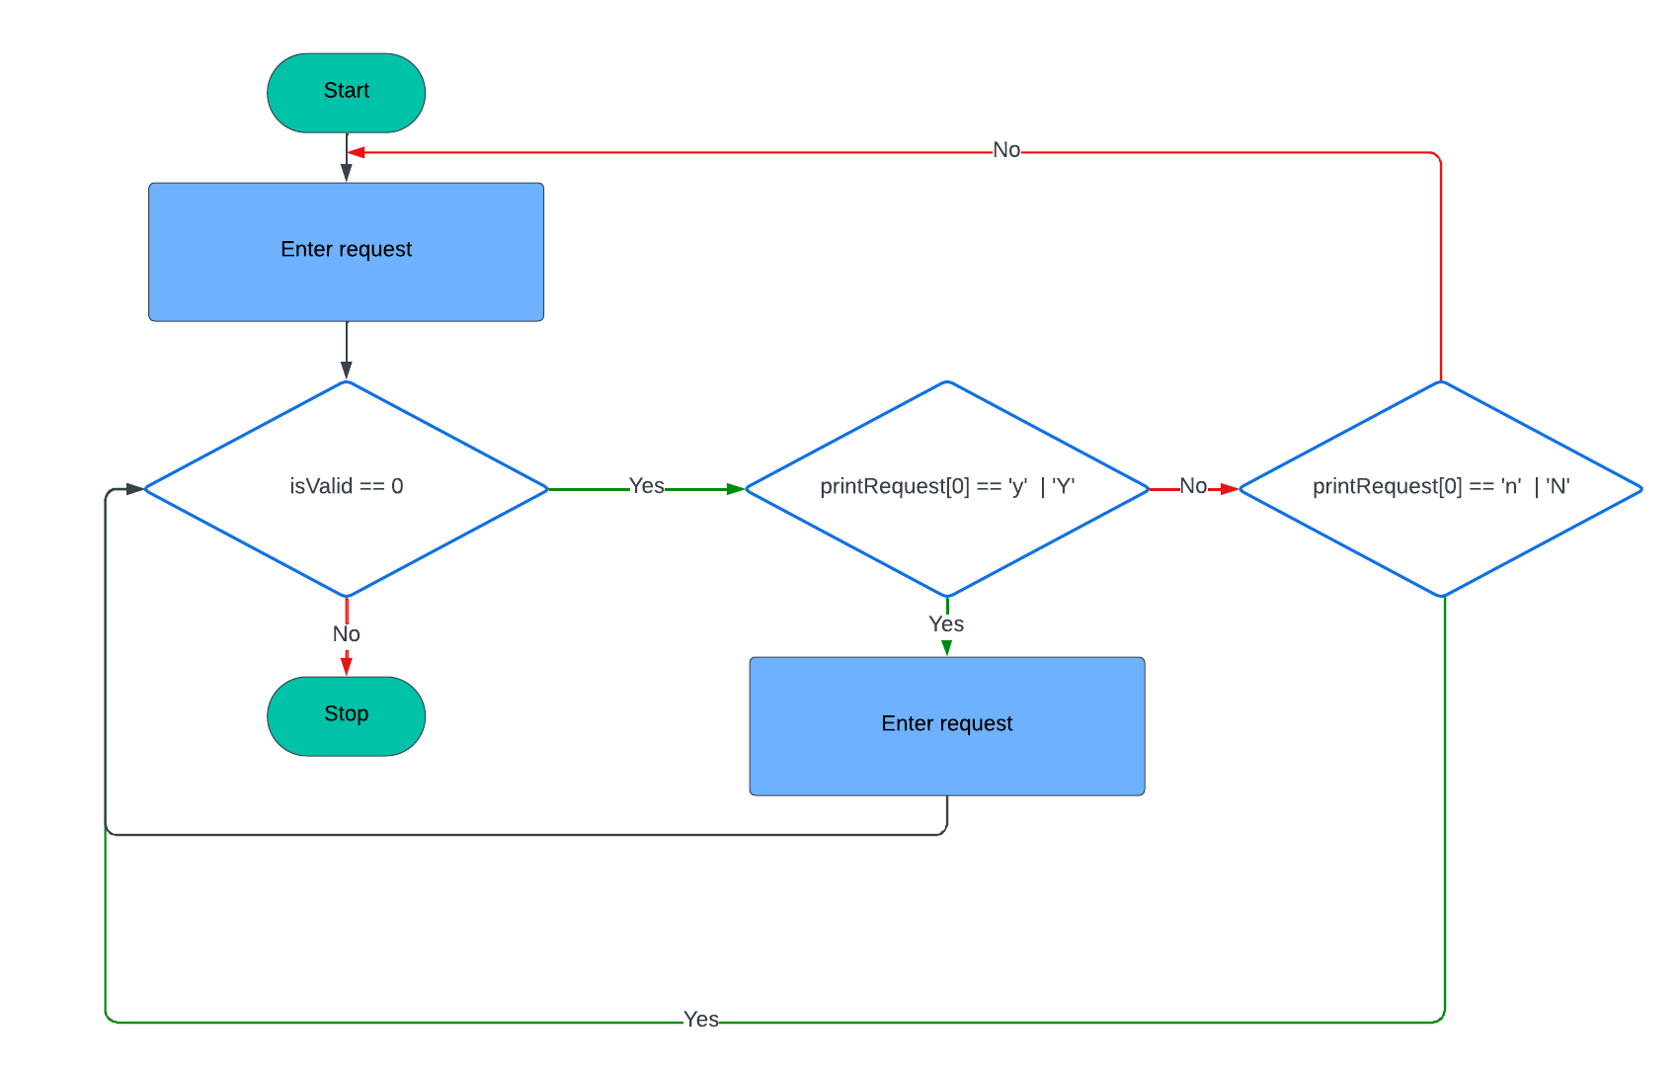
main() (Print table)
Note:
+ isValid: check input valid
+ printRequest: Store user’s request
11

Slide 12
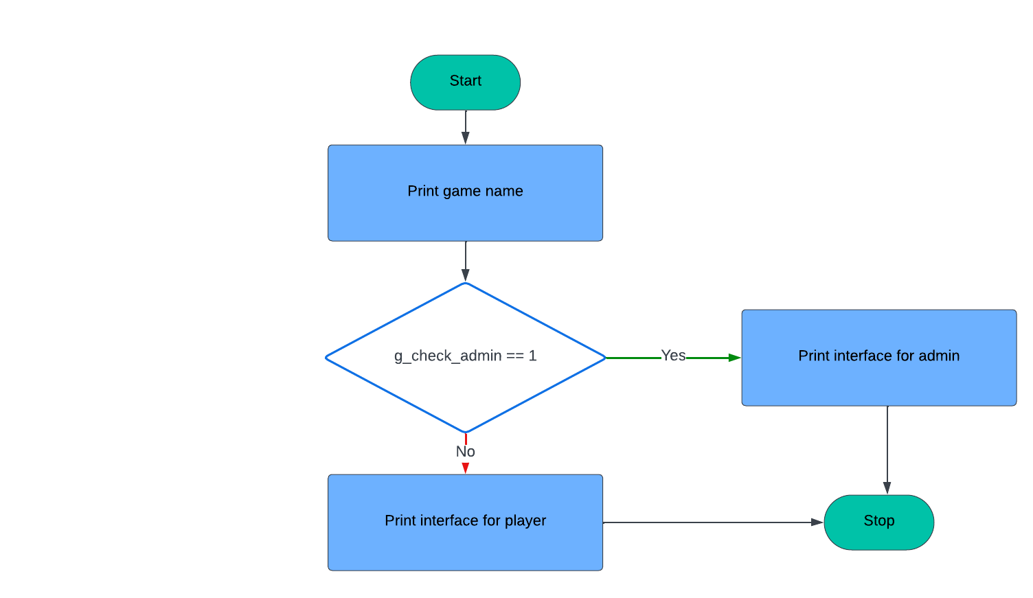
print_interface()
Note:
+ g_check_admin: check out account is
admin or not
12

Slide 13
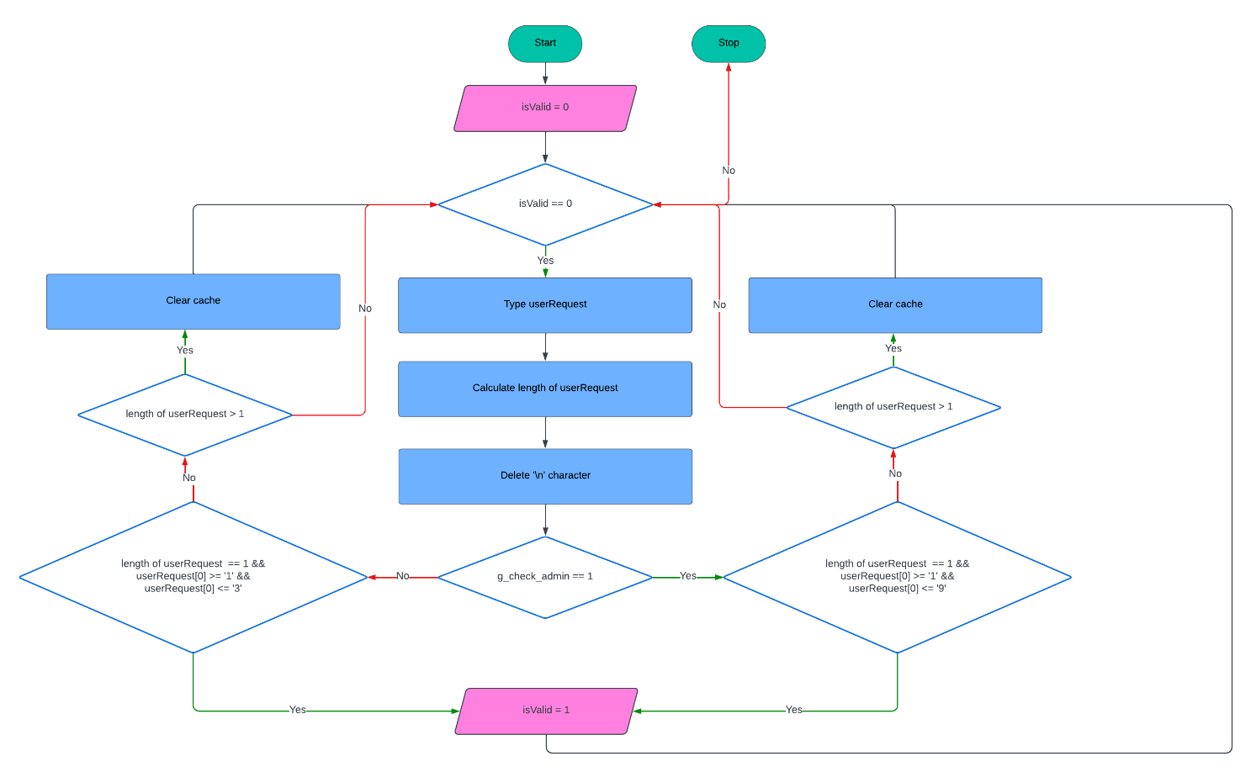
enter_request()
Note:
+ isValid: check input valid
+ userRequest: Store user’s request
+ g_check_admin:check out account is
admin or not
13

Slide 14
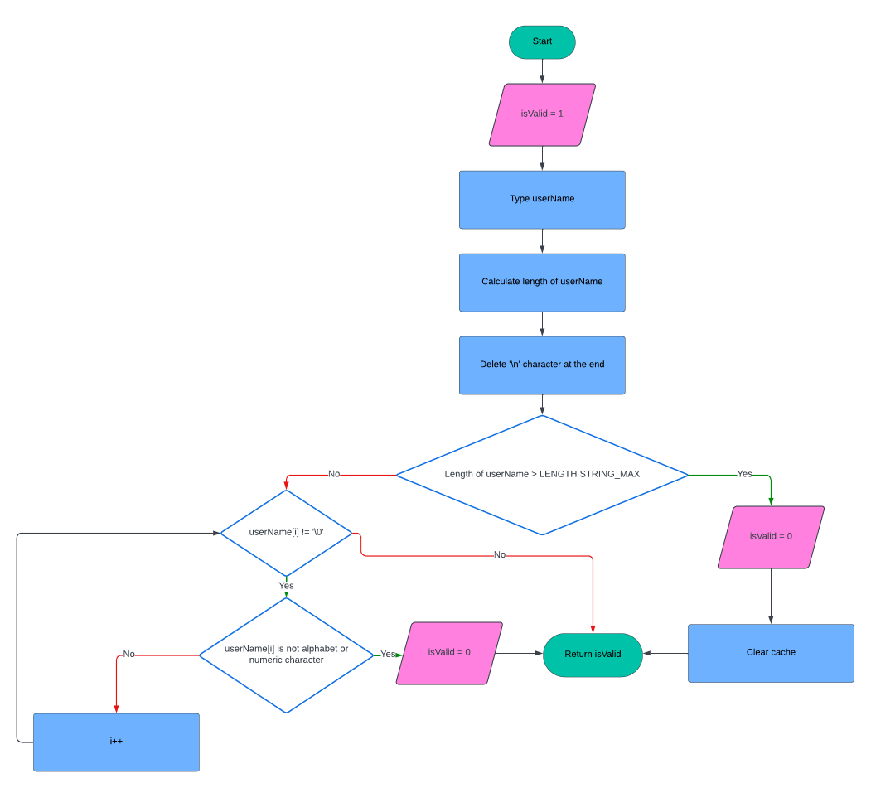
input_user_name()
Note:
+ isValid: check input valid
+ userName: Store user’s name
+ LENGTH_STRING_MAX: 20 character can
be stored in userName
+ i : count variable (=0 at initial)
14

Slide 15
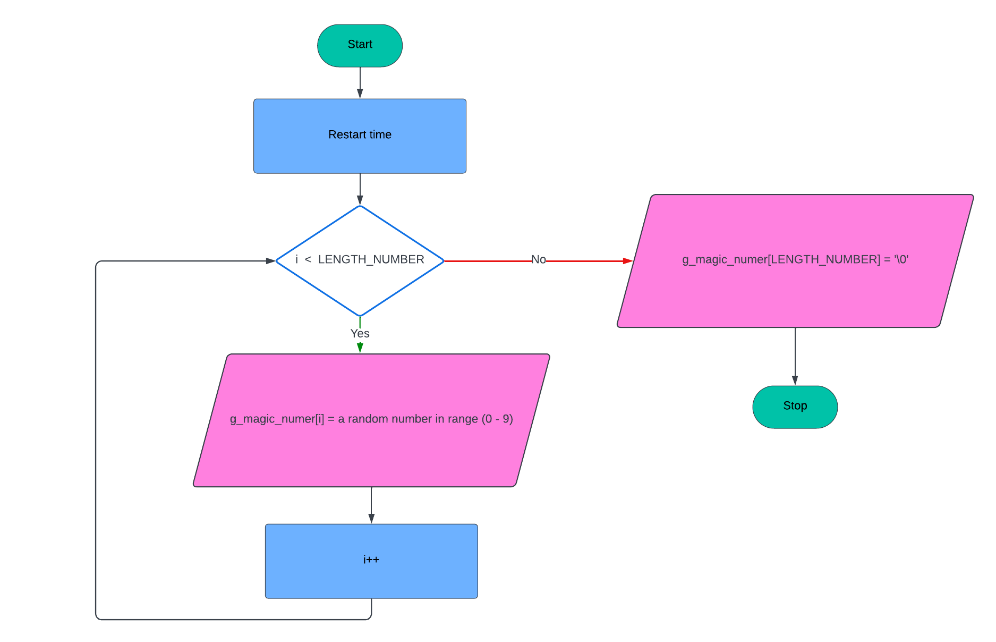
random_6_digits_number()
Note:
+ LENGTH_NUMBER: 6 numberic characters
can be stored in g_magic_number
+g_magic_number: store magic number
+ i : count variable(=0 at initial)
15

Slide 16
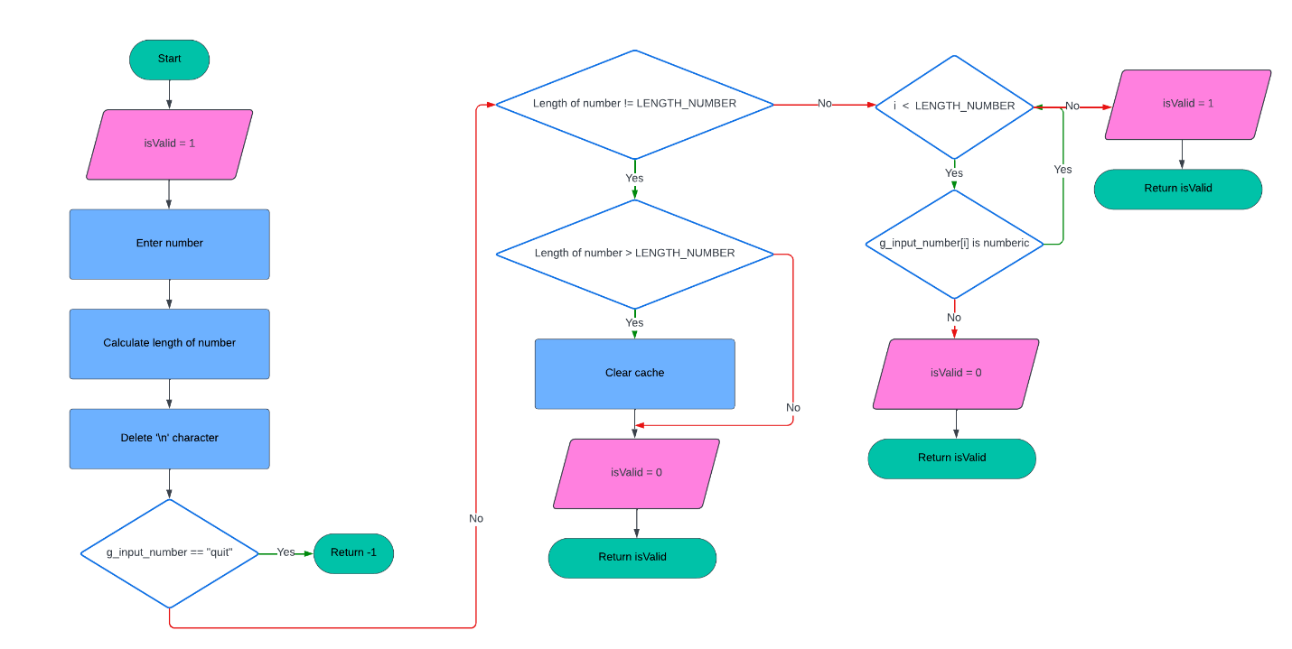
input_6_digits_number()
Note:
+ isValid: check input valid
+ LENGTH_NUMBER: 6 numberic characters
can be stored in g_input_number
+g_input_number: store user’s input
number
+ i : count variable(=0 at initial)
16

Slide 17
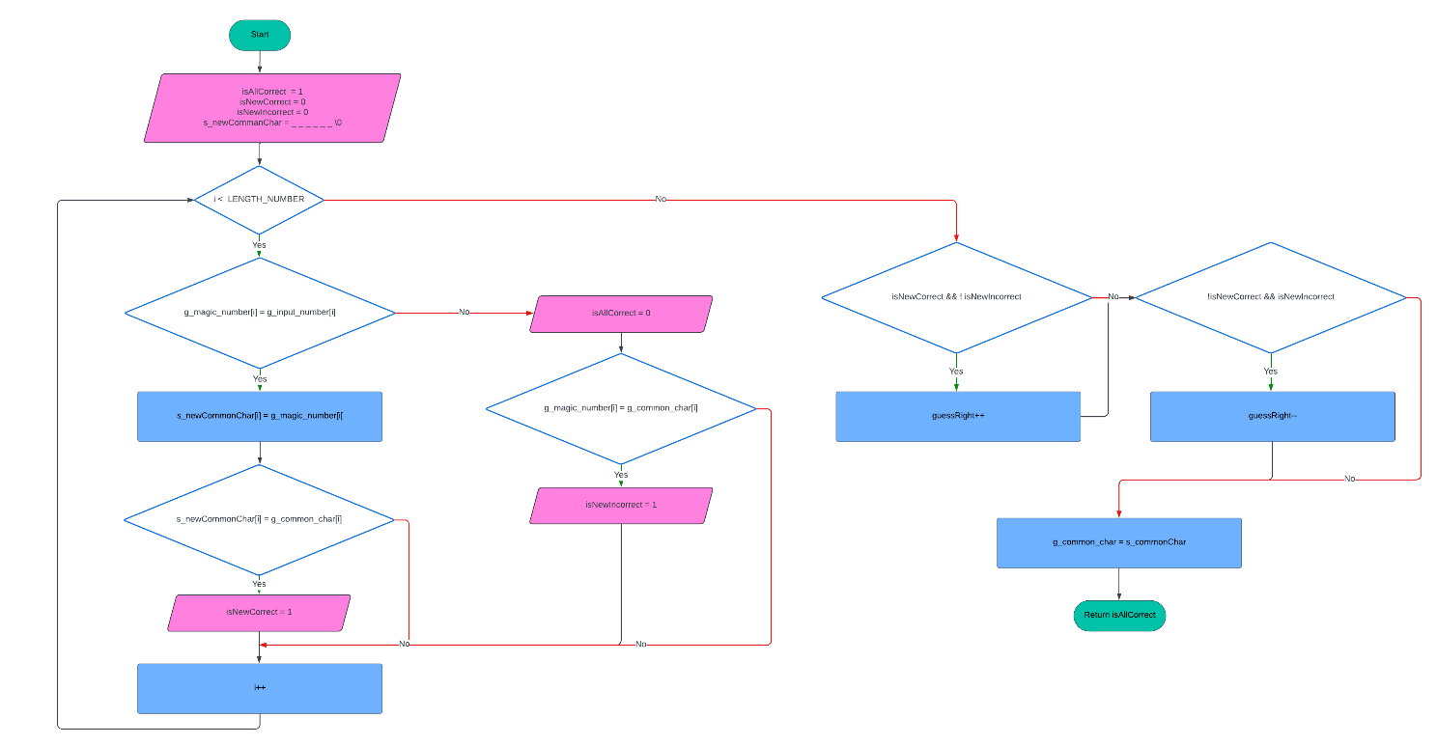
compare_2_string()
Note:
+ isAllCorrect: Check guess all done
+ LENGTH_NUMBER: 6 numberic characters
can be stored in g_input_number
+ i : count variable (=0 at initial)
+g_input_number: store user’s input number
+g_magic_number: store magic number
+g_common_char : store old common
characters
+ s_commonChar: store new common
characters
17

Slide 18
compare_2_string()
Note:
+ guessRight: store correctly guess time
+ isNewCorrect: detect new correctly guessed
Character
+ isNewCorrect: detect new incorrectly
guessed character
18

Slide 19
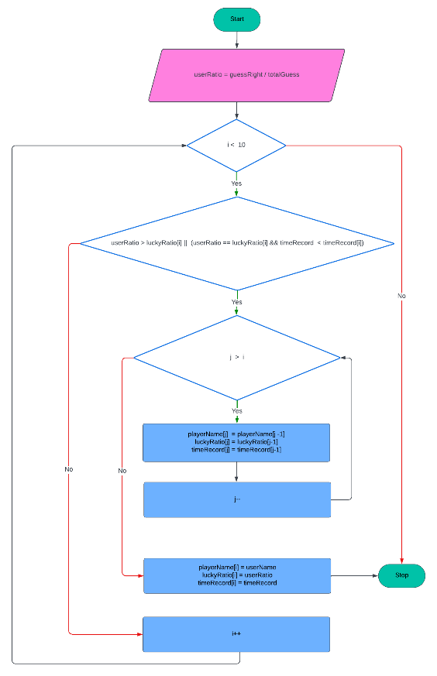
update_player_table()
Note:
+ userRatio, luckyRatio: store user’s ratio
+ playerName, userName: store user’s
name
+ timeRecord: user’s record
+ i,j : count variables (i = 0, j = 9 at initial)
19

Slide 20
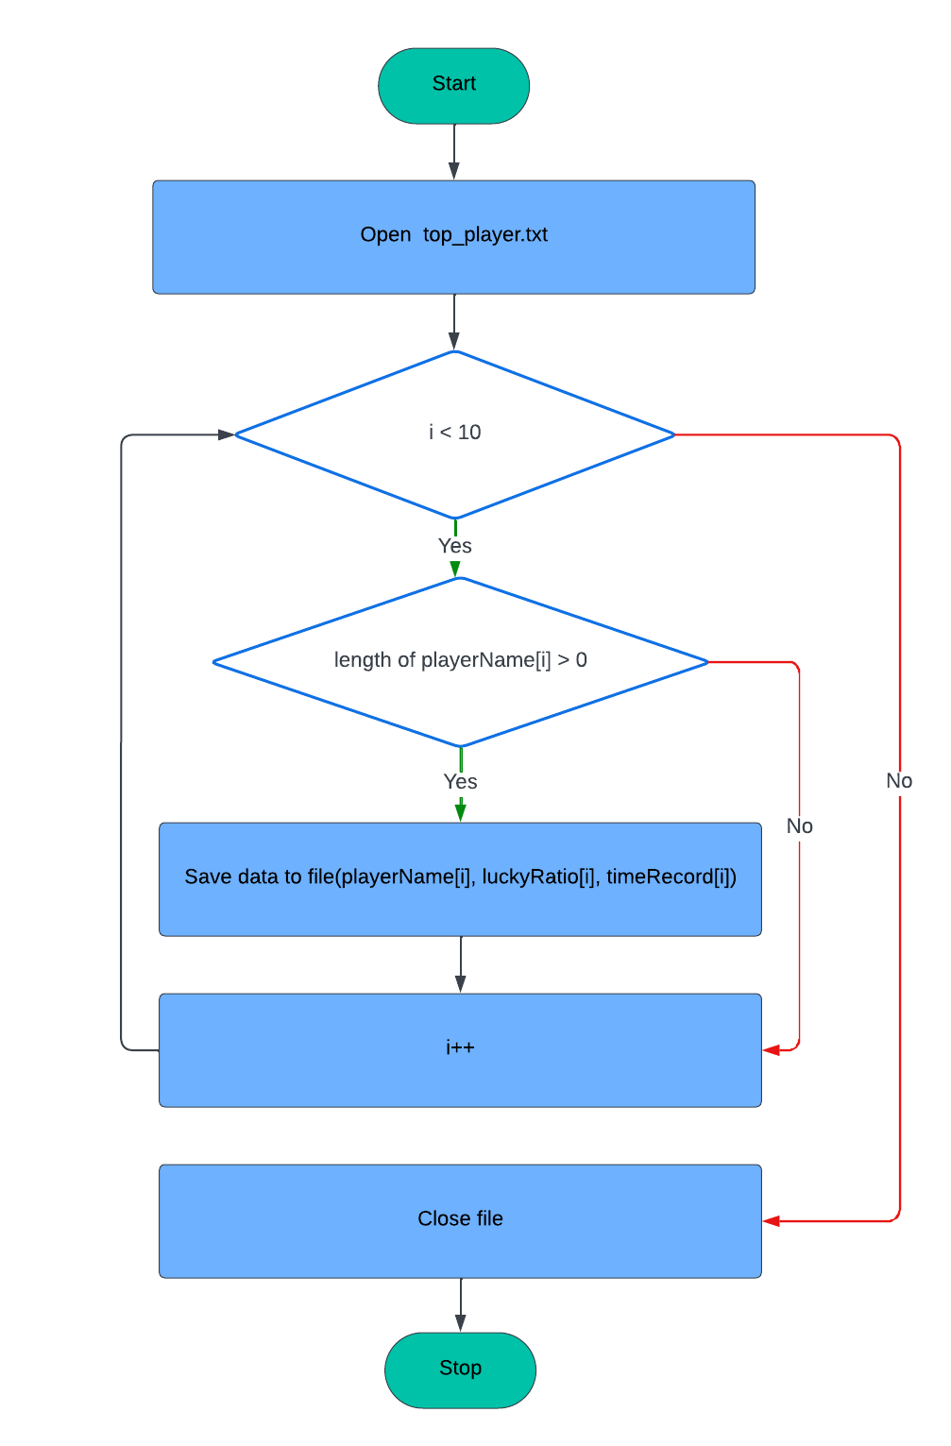
save_player_to_file()
Note:
+ i: count variable (=0 at initial)
+ playerName: store user’s name
+ luckyRatio: store user’s ratio
+ timeRecord: user’s record
20

Slide 21
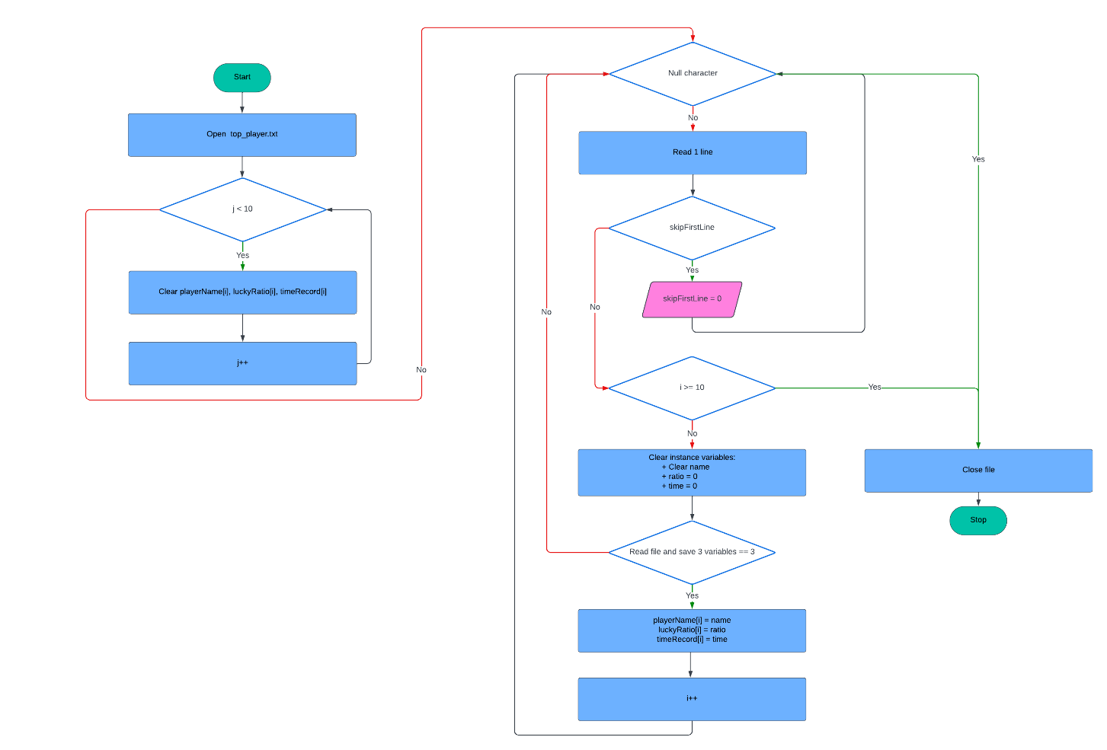
read_player_from_file()
Note:
+ i,j: count variables(=0 at initial)
+ playerName,name: store user’s name
+ luckyRatio,ratio: store user’s ratio
+ timeRecord,time: user’s record
+ skipFirstLine: detect to pass first line
21

Slide 22
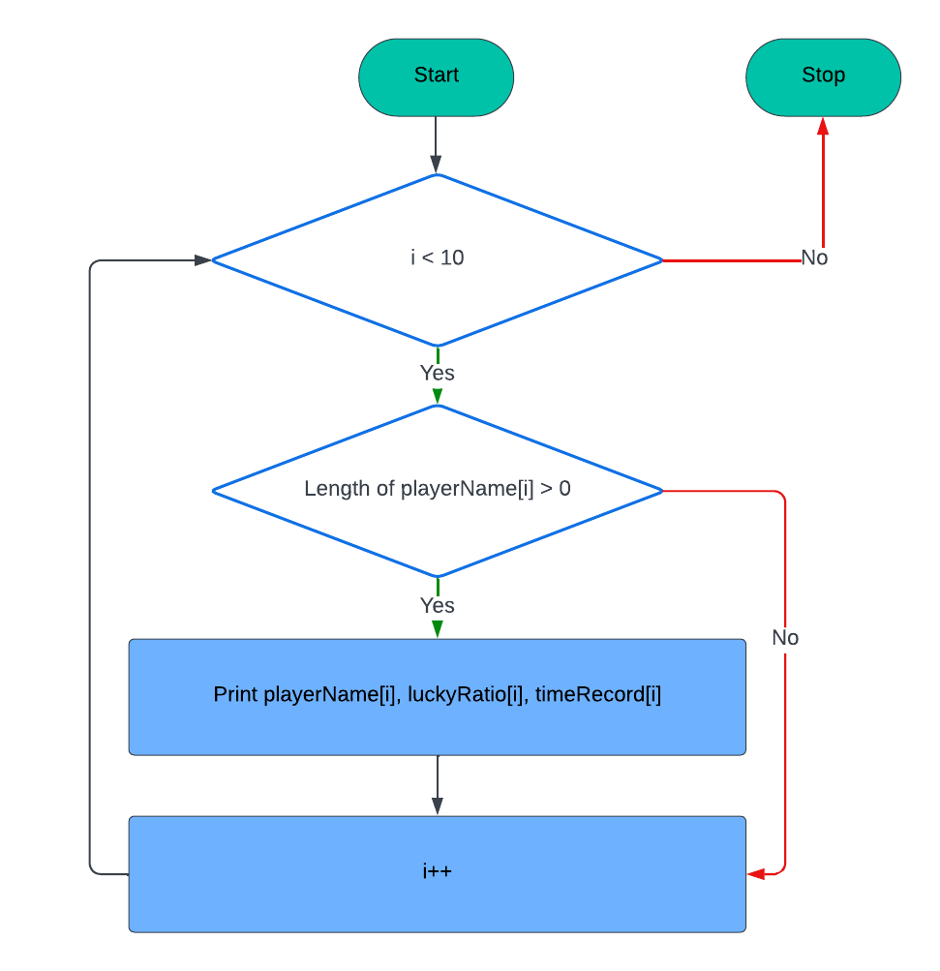
print_high_score()
Note:
+ i: count variable (=0 at initial)
+ playerName: store user’s name
+ luckyRatio: store user’s ratio
+ timeRecord: user’s record
22

Slide 23
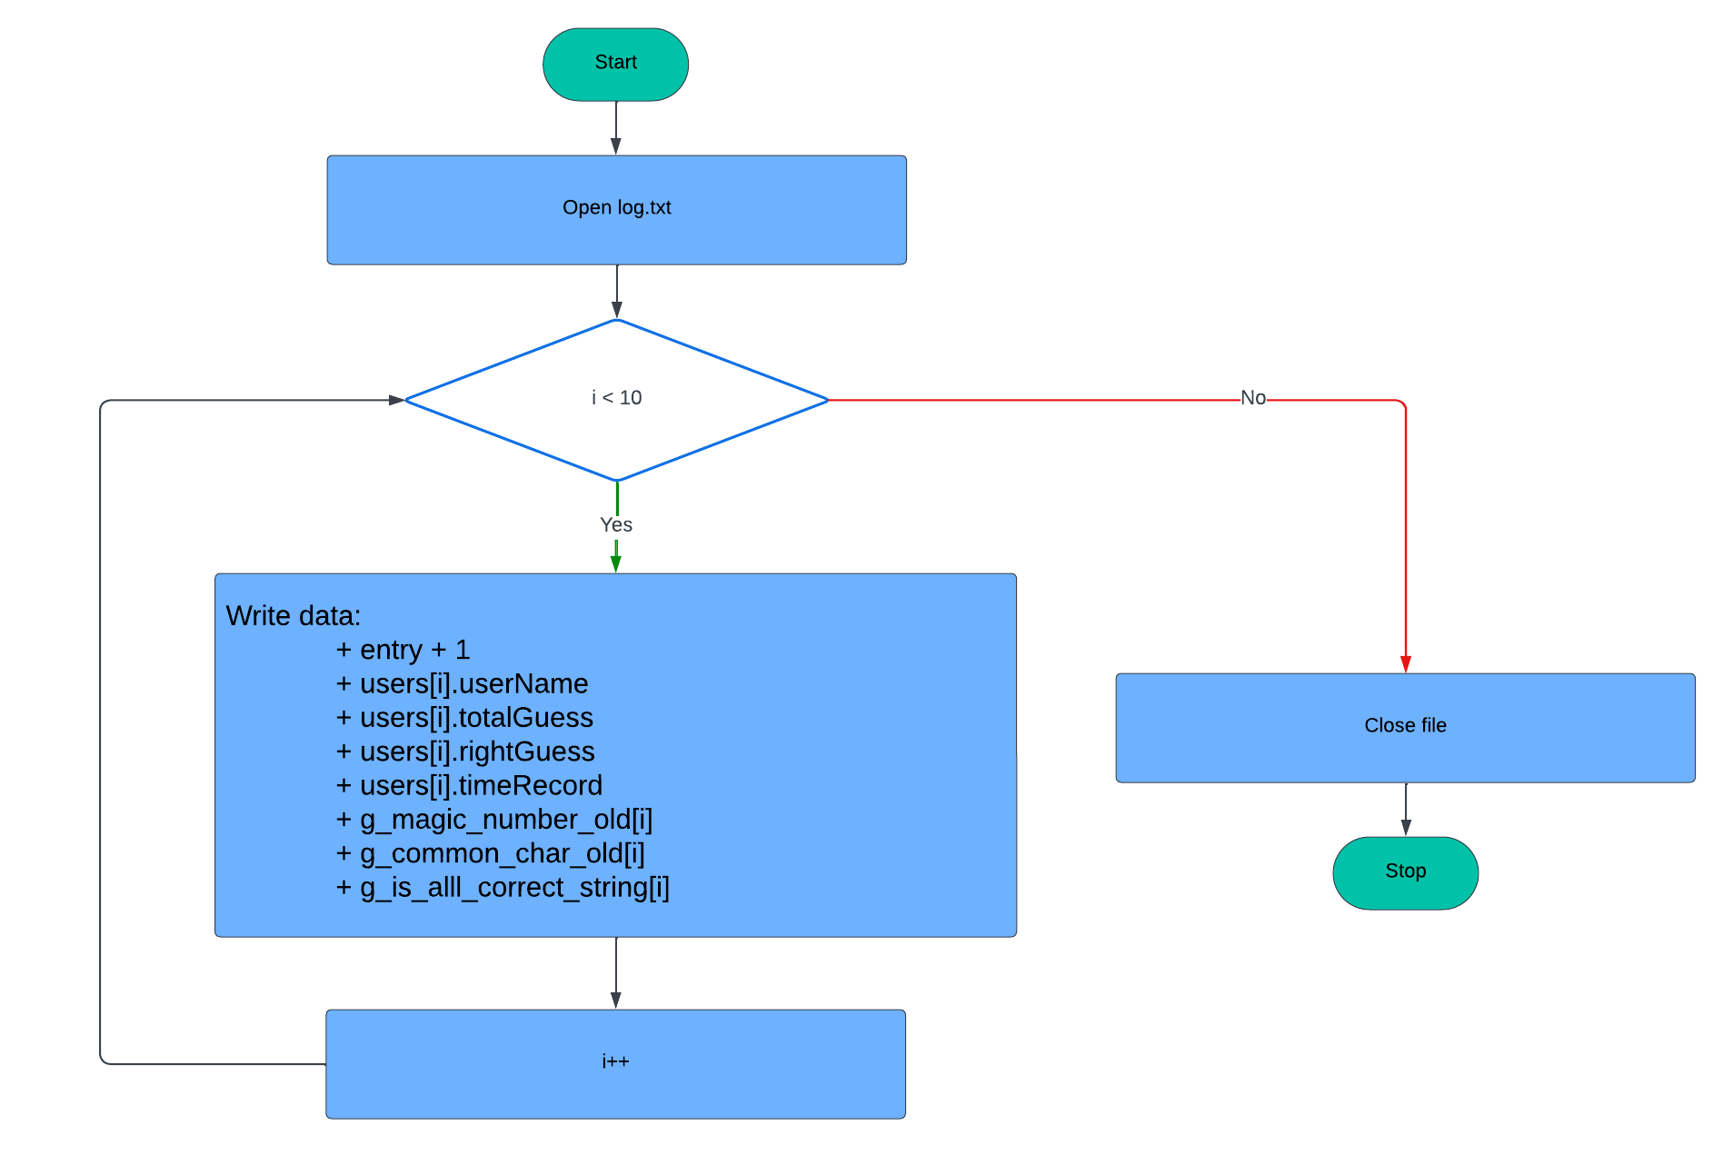
save_user_list_to_file()
Note:
+ i: count variables (= 0 at initial)
+ entry: number of saved players
+ playerName: store user’s name
+ luckyRatio: store user’s ratio
+ timeRecord: user’s record
+g_magic_number_old: string of 10 nearest
played magic numbers
+ g_common_char_old: : string of 10 nearest
played common char strings
+ g_is_all_correct_string: string of 10 nearest
playeds status of program
23

Slide 24
save_user_list_to_file()
Note:
+users: structure hold data of user (name,
ratio, time record)
24

Slide 25
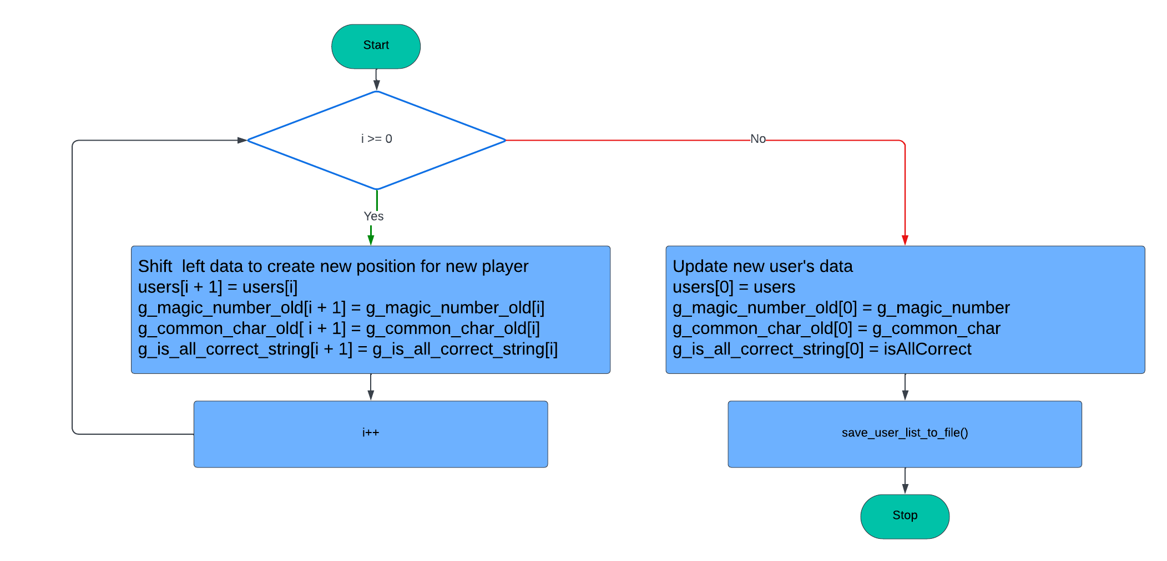
save_user_to_file()
Note:
+ i: count variables (= 9 at initial)
+users, user: structure hold data of user
(name, ratio, time record)
+g_magic_number_old: string of 10 nearest
played magic numbers
+ g_common_char_old: : string of 10 nearest
played common char strings
+ g_is_all_correct_string: string of 10 nearest
playeds status of program
+ isAllCorrect: status of program
25

Slide 26
Simulation
26

Slide 27
Thank you Q&A
27

